Slide 1
Animated cartography
Patxi Escobar
Dpt. of Geology, Geography and Environmental Sciences
University of Alcala
www.geogra.uah.es/patxi
Environmental Mapping Strategy - EXPLORERS EUROLAB 2O2O

Slide 2
Content
Introduction
Multimedia and Mapping
Principles of animation
Types of animation in mapping

Slide 3
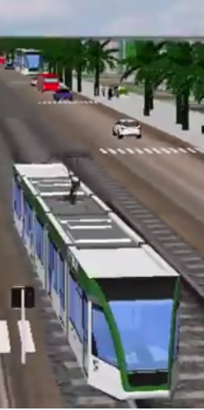
Introduction
Origins of multimedia: sequential representation of images (slides like) together with sound
Today: combined media with interactive links (interactive multimedia)
Multimedia is interaction with varying forms of media (text, graphs, images, sound, narration, animation, video…) supported by computers and internet

Slide 4
Multimedia and mapping
It multiplies the visualization possibilities on the varying dimensions that geographic data may adopt
It multiplies the visualization possibilities of its spatial and temporal evolution
It allows for faster and easier understanding
The essential question is: which media are better adapted to the objective pursued?
Well-used complementarity will result in the best outcomes

Slide 5
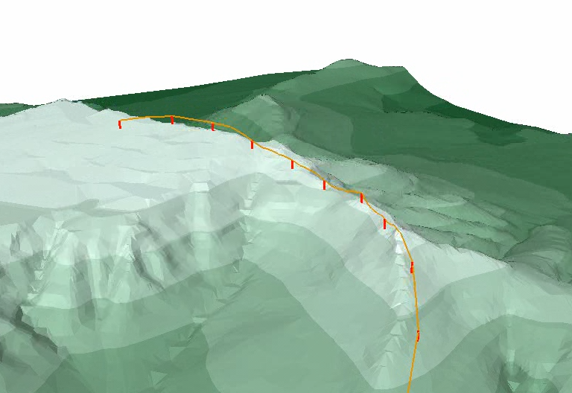
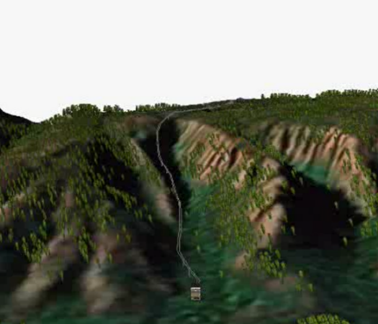
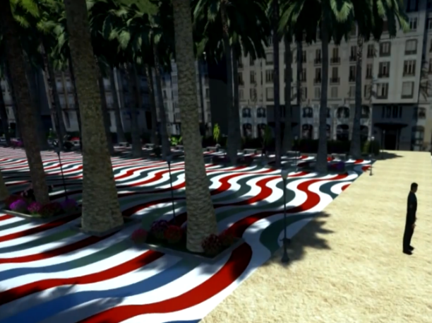
Attention must be paid to obsolescence
2002
2006
2015

Slide 6
Principles of animation
The human perceptual system is better tuned to perceive stimuli in motion than static stimuli [..]. People have special sensors to detect movement.
(Ormerling, 1995)

Slide 7
Animation constitutes a new branch of Cartography, despite the fact that cinema is over a hundred years old
Digital Revolution

Slide 8
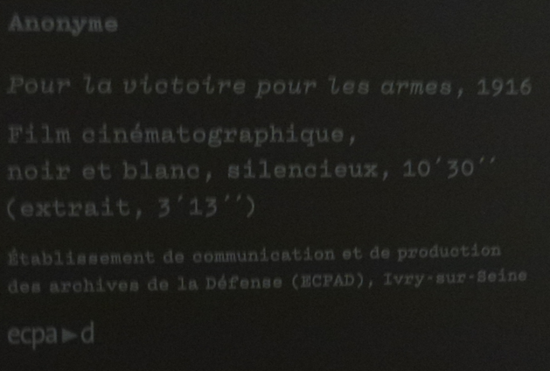
First animated map
Anonymous. “To victory by arms”, 1916. Silent film b/w, 10 ’30’ ’
Communication and production establishment of the Defense Archives (ECPAD), Ivry-sur-Seine

Slide 9
Animated Mapping
MacEarchen (1994) defines map as
Dynamic and interactive spatial information tools
Some kind of animation is necessary
(in multimedia software we call animation to
any interactive, animated object ... that performs an action)

Slide 10
Animation - definition
Animation is the technique or notion of movement applied to an element or individual
It is closely linked to graphic production

Slide 11

About animation
Origin
Quickly flipped pages
Perception of dynamic maps
Geometry
Theme
Time
Properties of perception
Size, colour, texture, orientation, shape
Principle
Continuous reality breaks in a series of similar images
http://www.animationckc.ir/contents/1106/Flip-book

Slide 12
About animation
What happens between those images is [could be] the most important part
(Peterson, 1995)

Slide 13
Animated map types
Types of changes (1)
  Shape
(Hayward, 1984) :

Slide 14
Types of changes (2):
  Location

Slide 15
Types of changes (3):
  Value

Slide 16
Types of changes (4):
  Texture

Slide 17
Type of changes (5):
  Perspective (ArcGIS 3D Scene)

Slide 18
Type of changes (6):
  Colour

Slide 19
Type of changes (7):
  Size

Slide 20
Type of changes (8):
  Hue

Slide 21
Type of changes (9):
  Scene

Slide 22
Type of changes (10):
  Zoom

Slide 23
Type of changes (11):
  Theme

Slide 24
Production methods
Computer animation
Create sequence
Display sequence
Composition method
Improvisation method
online
offline
computer assisted
programmed
algorithmic
video games
real
real time
film
animation
animation
animation
time
later
video
frame by
cast-based
frame
animation
(Koussoulakou and Kraak, 1992)

Slide 25
Tools for designing animations
Animation-specific semiotic variables (equivalent to visual variables in 2D traditional mapping)
  Data display
  Duration
  Frequency
  Order
  Exchange value
  Synchronization
  …
*

Slide 26
Implementation tools
Multimedia
Office
GIS
Animators (like GIFT animators)
Virtual Reality
Geo-visualization (like Forester)

Slide 27
Power Point

Slide 28
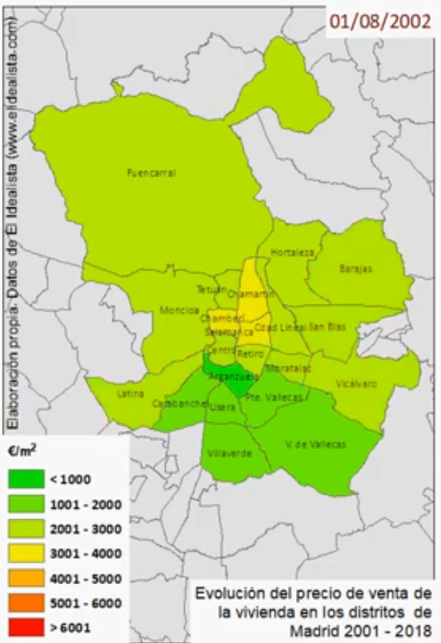
Animated visualization of real estate prices in Madrid

Slide 29
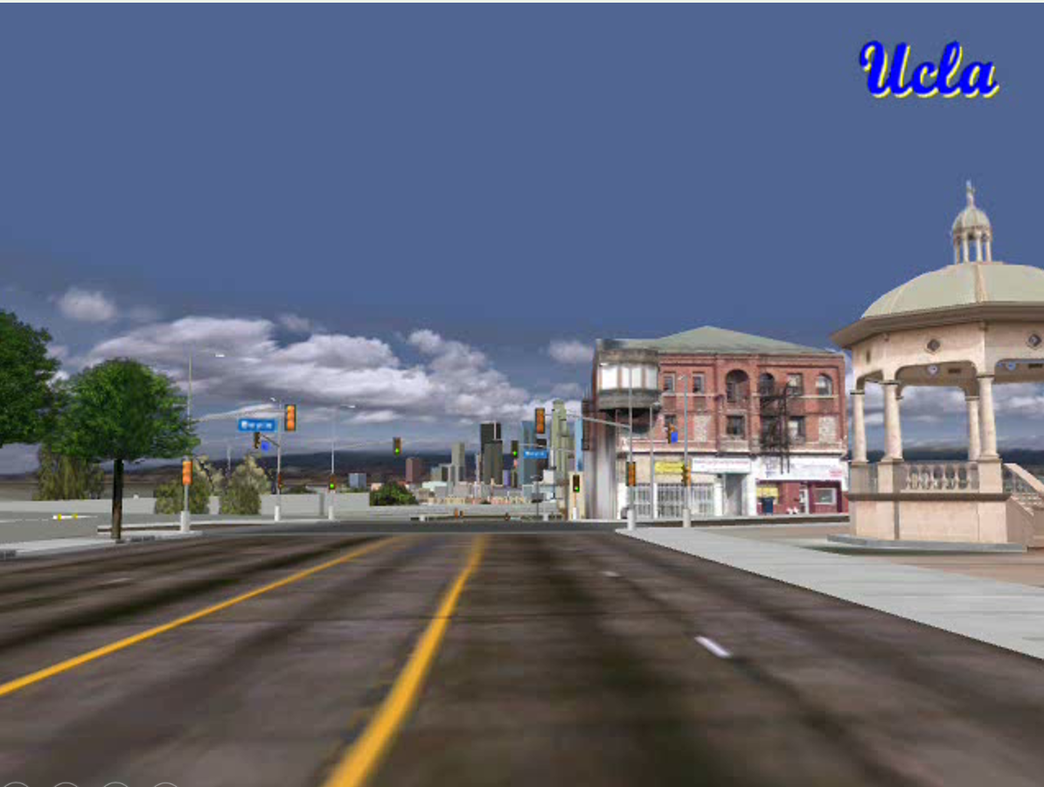
Visualization of Los Angeles UCLA University

Slide 30
Bibliography
Cauvin, C., Escobar, F. And Serradj, A, (2010), Thematic Cartography, 3 vols. Londres: Wiley
Brunsdon, C., Corcoran J., Higgs G., 2007, « Visualising space and time in crime patterns: a comparison of methods. », Computers, Environment and Urban Systems, vol.31, p. 52-75.
Cartwright W., Peterson M.P., Gartner G., 1999, Multimedia Cartography, Springer verlag, Berlin, 343 p.
DiBiase D., MaCEachren A.M., Krygier J. B., Reeves C., 1992, « Animation and the role of map design in scientific visualization », Cartography and geographic information systems, vol. 19, n° 4, p. 201-214.

